Slide 1
IMPLEMENTATION OF THE PERSPECTIVE COOPERATION BETWEEN RUSSIA AND INDIA IN THE NUCLEAR AREA
Mr. Nikita Mazein
Vice President,
Rusatom Overseas
11th Nuclear Energy Conclave
New Delhi,
18th October, 2019

Slide 2
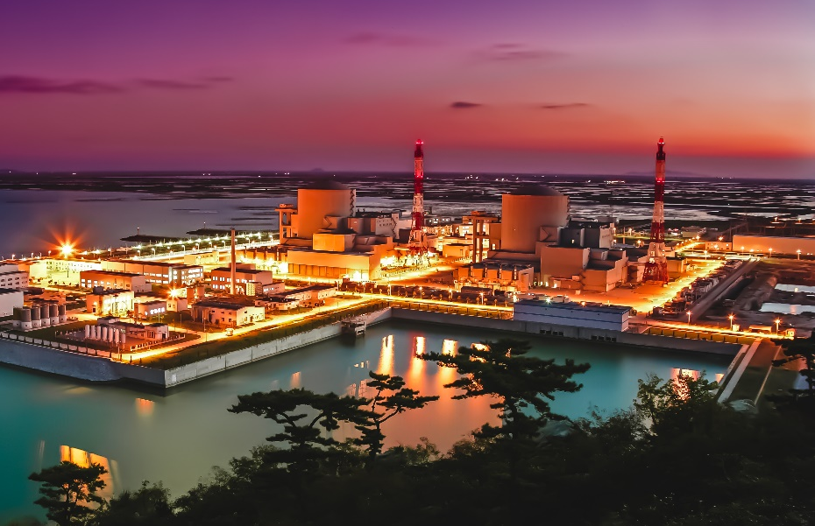
Rosatom’s Technology Global Success Story
77
GERMANY
6
VVER UNITS
2
RUSSIA
CZECH
REPUBLIC
FINLAND
23
BUILT
6
SLOVAKIA
UKRAINE
ARMENIA
15
2
6
HUNGARY
IRAN
CHINA
1
4
4
INDIA
2
BULGARIA
6
36 UNITS
ORDER BACKLOG
2

Slide 3
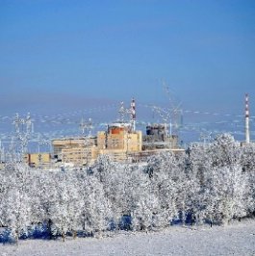
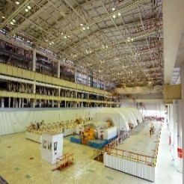
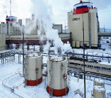
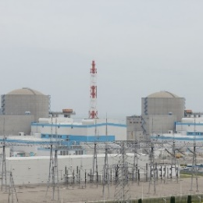
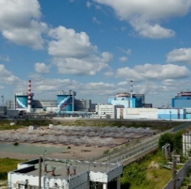
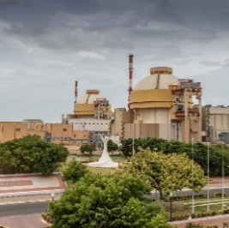
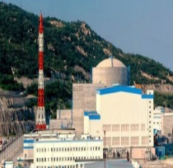
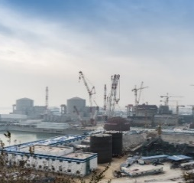
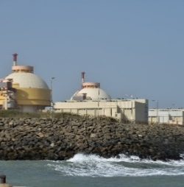
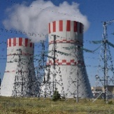
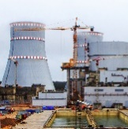
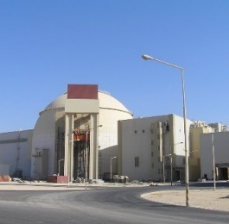
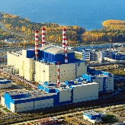
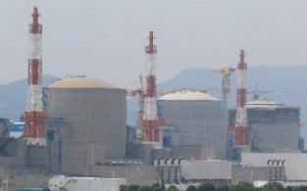
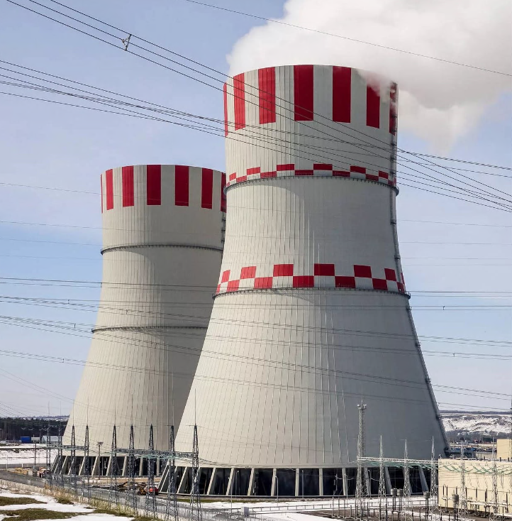
Rosatom is the Only Nuclear Vendor Implementing Serial NPP Construction at Home and Abroad
15 VVER NPP UNITS IN 14 YEARS CONNECTED TO GRID
Rostov 2
Rostov 3
Rostov 4
Tianwan 1
Kudankulam 2
Tianwan 4
Kalinin 4
2006
2007
2008
2009
2010
2011
2012
2013
2014
2015
2016
2017
2018
2019
Kudankulam 1
Novovoronezh 2-1
Tianwan 2
Leningrad 2-1
Beloyarsk 4
Novovoronezh 2-2
Busher 1
Tianwan 3
NPP construction abroad
NPP construction in Russia
3

Slide 4
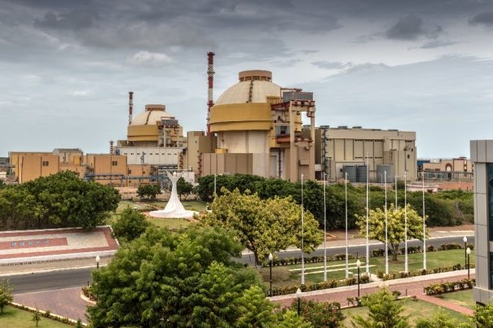
Benefits of Light Water Reactor Technology for India
Further developing VVER 1200 MW technology in India will be mutually beneficial step to achieve objective of strategic partnership between India and Russia in the nuclear area
Low-cost baseload electricity generation
Sustainable higher capacities utilization rate
Reduction in use of freshwater resources (for coastal sites)
Achieving targets in curbing greenhouses gases emissions
Secured long-term fuel supply and predictable operating costs
Significant multiplier effect in enhancing economic development of local area
Innovation and know-how transfer
New opportunities for localization
Rosatom is prepared with technical, financial and managerial solution to proceed with the NPP project execution on a new site in India
Existing intergovernmental nuclear cooperation agreements of 2008, 2010 and 2014 have been converted into an Action plan in 2018

Slide 5
Developing a New Cooperation Agenda
ACTION PLAN for Prioritization and Implementation of Cooperation Areas in the Nuclear Field Identified Jointly by Russia and India signed on the 5th October, 2018
Jointly reviewing of the proposed technical solutions and basic design for 6 VVER-1200 units on a second site in India
Considering various project execution models
Creating partnerships with respective public and private sector companies in India
Progressively increasing level of Indian industry involvement and localization via technology sharing and joint ventures
Enhancing further participation of Indian companies in the Russian-designed NPP projects in the third countries on competitive commercial terms
Considering cooperation opportunities in other civil nuclear energy applications

Slide 6
Rosatom: a Partner of Choice in India
Russia has proved to be a reliable long-term strategic partner of India for the nuclear energy industry over decades
Reference plant in operation in Russia – Novovoronezh-II NPP with proven design for VVER-1200
Indian experts are familiar with the Russian norms and standards, having built well-established cooperation with design organizations from Russia
Economy of scale and cost reduction shall be achieved with larger capacity units
Progressive localization and local industry participation for mutual benefits and consistency with “Make in India” programme
Rosatom provides its overseas customers with the unique integrated solution including support throughout the complete NPP lifecycle as well as comprehensive expertise in other civil nuclear energy applications
The content of this presentation is for discussion purposes only, shall not be considered as an offer and doesn’t lead to any obligations by Rosatom and its affiliated companies. Rosatom disclaims all responsibility for any and all mistakes, quality and completeness of the information.
6
Notes:
http://www.rosatom.ru/en/about/
http://www.iaea.org/NuclearPower/Downloadable/Meetings/2014/2014-09-8-09-10-TM-NPE/7._Russia_Rosatom_for_IAEA.pdf

Slide 7


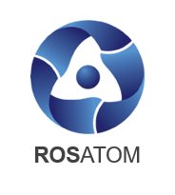

Cooperation To Be Extended Beyond NPP Construction
ENERGY SECTOR
U-235
Enrichment
and Conversion
Uranium Mining
Nuclear
Medicine
Gamma Irradiation
Fuel
Fabrication
Research
Reactors
Equipment Manufacturing
Isotopes
Small modular reactors
Floating NPP
NPP Construction, Operation, and Maintenance
Space Nuclear Power units
Nuclear icebreaker fleet
Power Generation
Back End
NON-ENERGY SECTOR

Slide 8
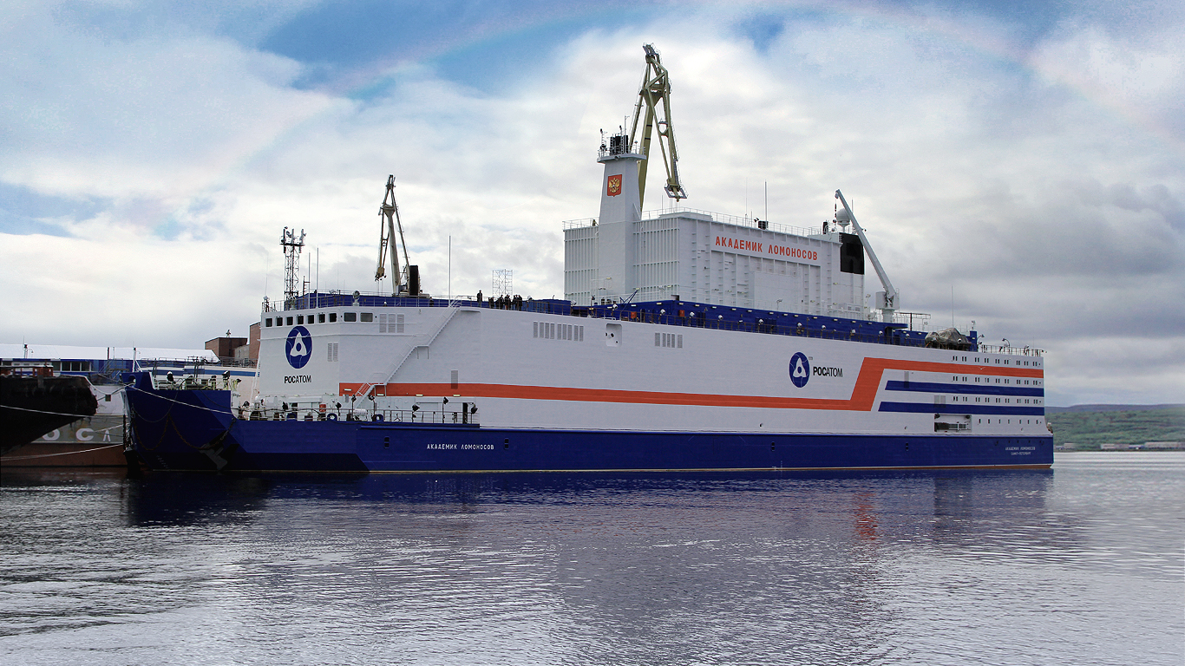
World’s First Floating Nuclear Power Plant (FNPP)
AKADEMIK LOMONOSOV
FNPP
  COMMISSIONING DATE: 2019
FIRST-OF-A-KIND
FLOATING NUCLEAR POWER PLANT
8

Slide 9
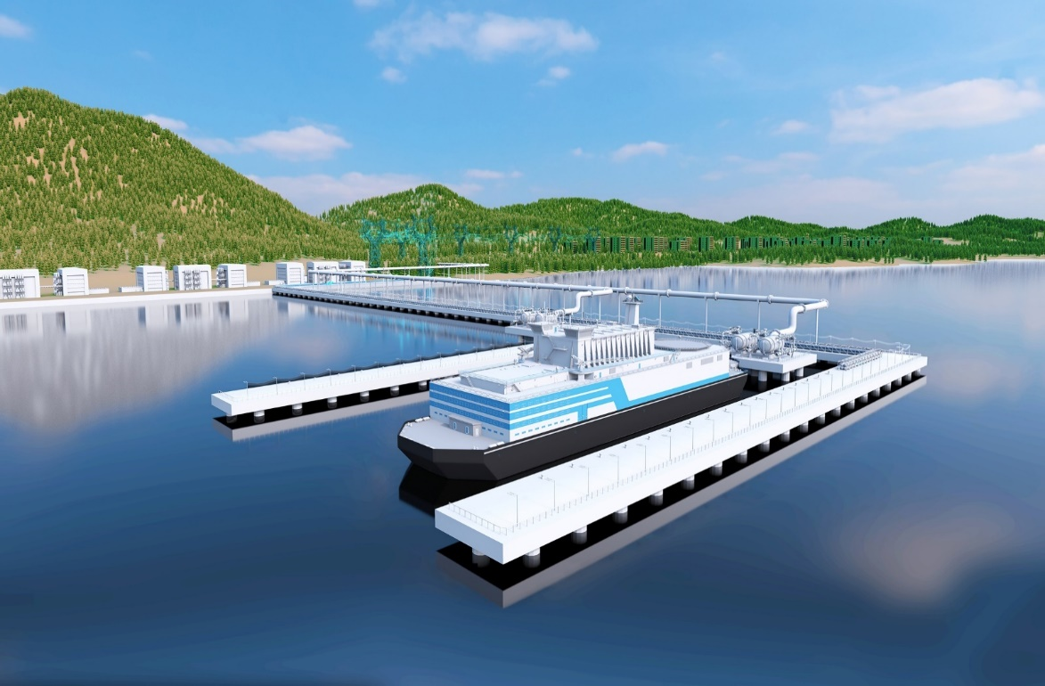
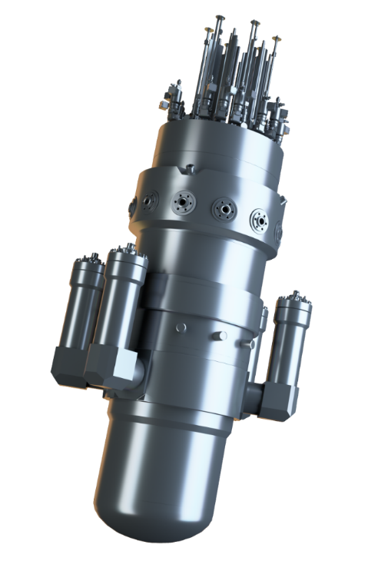
  FNPP: Optimized Mobile Solution of Power Supply in the Coastal Areas
  2×RITM-200M REACTOR UNIT
ELECTRICITY
HEAT
DESALINATION
by 9 000 t – displacement reduction
TECHNICAL PARAMETERS
Electric capacity | 100 MW
Refueling cycle | up to 10 years
Design life | 60 years
Displacement | 12 000 tons
Length | 112 m
Beam | 25 m
Draught | 4.5 m
by 28 m – length reduction
by 5 m – beam reduction
30% – capacity increase

Slide 10
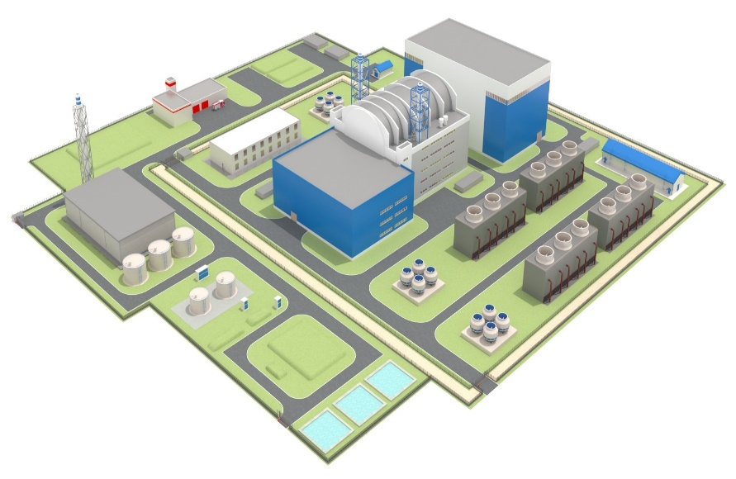
  Onshore Based Small Capacity NPP
  2×RITM-200M REACTOR UNIT
TECHNICAL PARAMETERS
Electrical capacity | 114 MW (2 x 57 MW)
Thermal capacity | 330 MW (2 x 165 MW)
Refueling cycle | up to 6 years
Design life | 60 years
Availability factor | 90%
Plant area | 15 acres (0.06 km²)
Construction period | 3 - 4 years
Modularity available
H₂
ELECTRICITY
HEAT
DESALINATION
HYDROGEN
  FLEXIBLE, TAILOR-MADE SMALL NPP SOLUTION BASED ON RITM SMR IS DESIGNED TO ADDRESS A WIDE RANGE OF CUSTOMER DEMANDS

Slide 11


Towards New Partnership Horizons
SHIFT FROM THE PROJECT FOCUS TO
COMPREHENSIVE STRATEGIC COLLABORATION
Rosatom’s VVER technology is one of the most successful among the light-water reactors units built around the globe in recent decades
Rosatom has proved to be a reliable long-term strategic partner of India and is willing to extend cooperation beyond the current level
Rosatom is prepared to develop comprehensive collaboration agenda in the new areas:
Cooperation with Indian companies in the third countries
Joint development of civil nuclear energy products
Localization of the NPP equipment and fuel

Slide 12
Q&A
Contact me at:
tel.: +7 (495) 280 00 14, ext. 5235
e-mail: nivmazein@rosatom.ru

